Slide 1
CDBM 602 Data Engineering
CRISP-DM Introduction
Instructor
Mr. Himanshu Patel, Ph.D.
Students
Vinh Vu - Ke Zhang- Huijuan Zheng

Slide 2





CRISP-DM INTRODUCTION WHAT, WHY, HOW, AND KEY TAKE AWAY
CRISP-DM (Cross-Industry Standard Process for Data Mining) is a practical, tool-agnostic lifecycle that guides data projects from a business question to a deployed solution. In this session, we will:
Explain what CRISP-DM is and why organizations adopt it across industries.
Walk through the six phases and show how they connect in an iterative loop.
Illustrate the value of shared deliverables for smooth team handoffs.
Provide a mini checklist you can reuse in course projects.

Slide 3


WHY DATA PROJECTS NEED A STRUCTURED PROCESS?
Many projects fail for predictable reasons, common failure patterns:
business goals are vague or change midstream;
teams “jump to modeling” before understanding the data;
quality issues appear late and cause rework;
handoffs are unclear;
and there is no shared language about readiness, risks, or success.
A structured process like CRISP-DM reduces these risks by forcing early agreement on outcomes, front-loading data understanding and quality checks, defining concrete deliverables per phase, and normalizing iteration when new evidence appears.

Slide 4



WHAT CRISP-DM IS (AND IS NOT)
CRISP-DM is an end-to-end lifecycle for data work: from business framing, through data understanding and preparation, to modeling, evaluation, and deployment.
It is technology-neutral and repeatable, emphasizing auditable deliverables and decisions.
It is not a rigid waterfall.
Loops are expected (e.g., evaluation can send you back to data preparation or even business reframing).
The outcome is not a metric alone; it is a solution that creates measurable business value in production.

Slide 5
THE SIX PHASES AT A GLANCE
1.Business Understanding: What problem are we solving, for whom, under which constraints, and how will we recognize success?
6.Deployment: How do we integrate, monitor, and iterate safely in real systems?
2.Data Understanding: What data exists, what is missing, how good is it, and what does early exploration reveal?
5.Evaluation: Do results satisfy both statistical criteria and business KPIs, and what risks remain?
CRISP-DM
4.Modeling: Which candidates should we try, how do we tune and compare them, and how do we log experiments?
3.Data Preparation: How do we clean, transform, and engineer features to create a reliable modeling table?

Slide 6

ITERATION, INPUTS/OUTPUTS, AND WHY DELIVERABLES MATTER
CRISP-DM is deliberately iterative: evaluation often exposes issues that send us back to preparation or even business reframing.
Clear inputs/outputs per phase make these loops cheap:
Business Understanding → Problem statement, KPIs, assumption log
Data Understanding → Data inventory, quality report, EDA highlight
Data Preparation → Cleaned tables, feature catalog, train/val/test splits, leakage checks
Modeling → Baseline + candidates, parameters, metrics, experiment log
Evaluation → Error analysis, business interpretation, go/no-go decision.
Deployment → API/service, monitoring plan (latency, drift), rollback steps

Slide 7


PHASE 1: BUSINESS UNDERSTANDING
HOW TO FRAME THE WORK
Goal: Understanding the objectives and requirements of the project.
Key activities: determine the business objectives, assess the current situation, identify the Data mining goals, and produce a project plan.
Typical outputs: a concise problem statement, KPI sheet with success criteria, assumption log, and initial risk register.
Quality bar: understand the business domain, business objectives and business problem that can be solved using a data-driven approach.

Slide 8
PHASE 2: DATA UNDERSTANDING
MAKE UNKNOWNS VISIBLE EARLY
Goal: Discover what data exists and whether it can answer the business question.
Key activities: Collect initial data, describe the data, explore the data and verify data quality.
Typical outputs: list of data sources, description of the data, the number of columns, rows, description of the columns, Exploratory Data Analysis – EDA, and verify data quality.
Quality bar: stakeholders can see constraints now (e.g., sparsity, drift), not weeks later.

Slide 9
PHASE 3: DATA PREPARATION
CREATE A RELIABLE MODELING ASSET
Goal: Produce a trustworthy, well-documented feature table that is required for data modeling.
Key activities: Select data, clean data, construct data, integrate data and format data.
Typical outputs: cleaned tables, a feature catalogue (name, definition, lineage, refresh), train/validation/test splits, and explicit leakage checks.
Quality bar: another teammate can rebuild the table reproducibly and explain each feature to a stakeholder.

Slide 10
PHASE 4: MODELING
BUILDING MACHINE LEARNING MODEL
Goal: Build and assess a lot of machine learning models and interpret the output of the model.
Key activities: select modeling techniques, generate test design, build model and assess model.
Typical outputs: select the model that will give you the optimal results and is meeting the success criteria defined in the business understanding phase.
Quality bar: decisions are explainable; experiments are traceable; gains over baseline are real, not artifacts of leakage or split errors.

Slide 11
PHASE 5: EVALUATION
STATISTICS MEET BUSINESS REALITY
Goal: Decide if the solution is acceptable for the business, not just the metric.
Key activities: evaluate results, review process, and determine next steps.
Typical outputs: a concise go/no-go memo that ties numbers to business impact, lists residual risks, and proposes mitigations.
Quality bar: stakeholders understand trade-offs and approve the decision.

Slide 12
PHASE 6: DEPLOYMENT
INTEGRATION, MONITORING, SAFE ITERATION
Goal: Operate the solution where it matters and keep it healthy.
Key activities: plan deployment, plan monitoring and maintenance, produce final report and review project.
Typical outputs: deployment diagram, API/batch spec, monitoring dashboard, alert thresholds, and an iteration playbook.
Quality bar: the system is observable, reversible, and aligned with the original business goal.

Slide 13






ROLES AND COLLABORATION
Successful projects thrive on interdisciplinary teamwork, bringing together diverse expertise to navigate each phase effectively.
Business Analyst
Data Scientist
Defines project objectives and translates business questions into data mining problems, ensuring relevance and impact.
Develops, tests, and refines predictive models, applying advanced analytical techniques to uncover insights.
Data Engineer
Project Manager
Manages data acquisition, cleaning, and transformation, building robust data pipelines for analysis and modeling.
Oversees the project lifecycle, coordinates team efforts, manages stakeholders, and tracks progress against goals.
Deployment Specialist
Integrates the final model into operational systems, ensuring seamless implementation and continuous monitoring.
CRISP-DM clarifies responsibilities without heavy process. Typical mapping:
Product/Domain: problem framing, KPIs, constraints, acceptance.
Data: source discovery, access, profiling, quality controls.
ML/Analytics: feature engineering, modeling, evaluation translation.
Engineering/DevOps: integration, reliability, monitoring, rollback.
Everyone: documentation and ethics (privacy, bias, security).

Slide 14
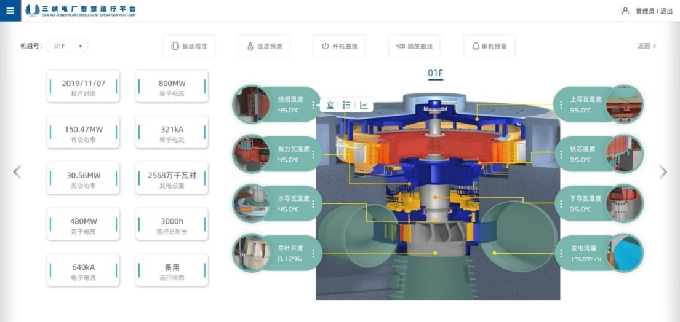
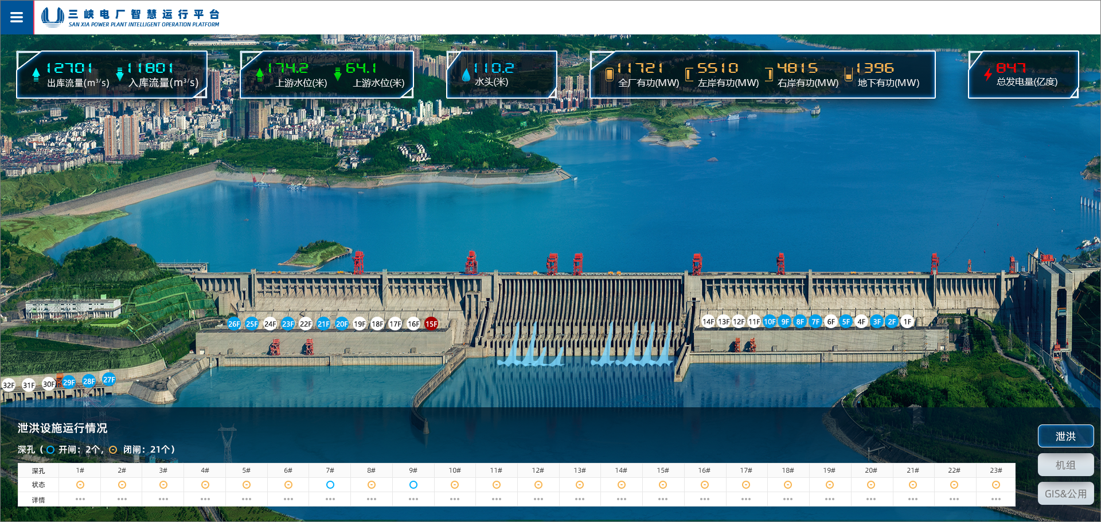
Bearing Temperature Anomaly Detection in the Three Gorges Hydropower Unit
Business Understanding
Prevent unplanned outages caused by bearing overheating
while reducing false alarms and missed detections.
Improve monitoring accuracy
Enhance failure prediction timing
Minimize operational disruption
Key Performance Indicators
Measurable targets for system effectiveness
and operational excellence.
Lower false alarm rate
Higher early warning accuracy
Increased average lead time before failure

Slide 15



CRISP-DM Workflow Implementation
Data Understanding
Data Preparation
Modeling
Bearing temperature time series data with single variable monitoring. Identifies daily/seasonal patterns and temperature spikes during turbine start/stop cycles.
Handle missing values through interpolation or exclusion. Apply smoothing techniques using moving average or median filters. Tag operating conditions by load levels.
Dynamic threshold = rolling quantile (Q95) + safety margin Δ. Alarm triggers when temperature exceeds threshold for N consecutive data points.
Evaluation Metrics
Compare against historical operator alarm logs using precision, recall, F1 score, and early warning lead time.
Baseline comparison with fixed 85°C threshold.
Deployment Strategy
Real-time dashboard displays temperature with threshold bands. Configurable parameters include window size, quantile levels, safety margins, and persistence requirements.

Slide 16
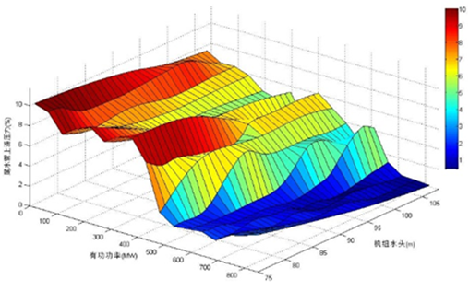
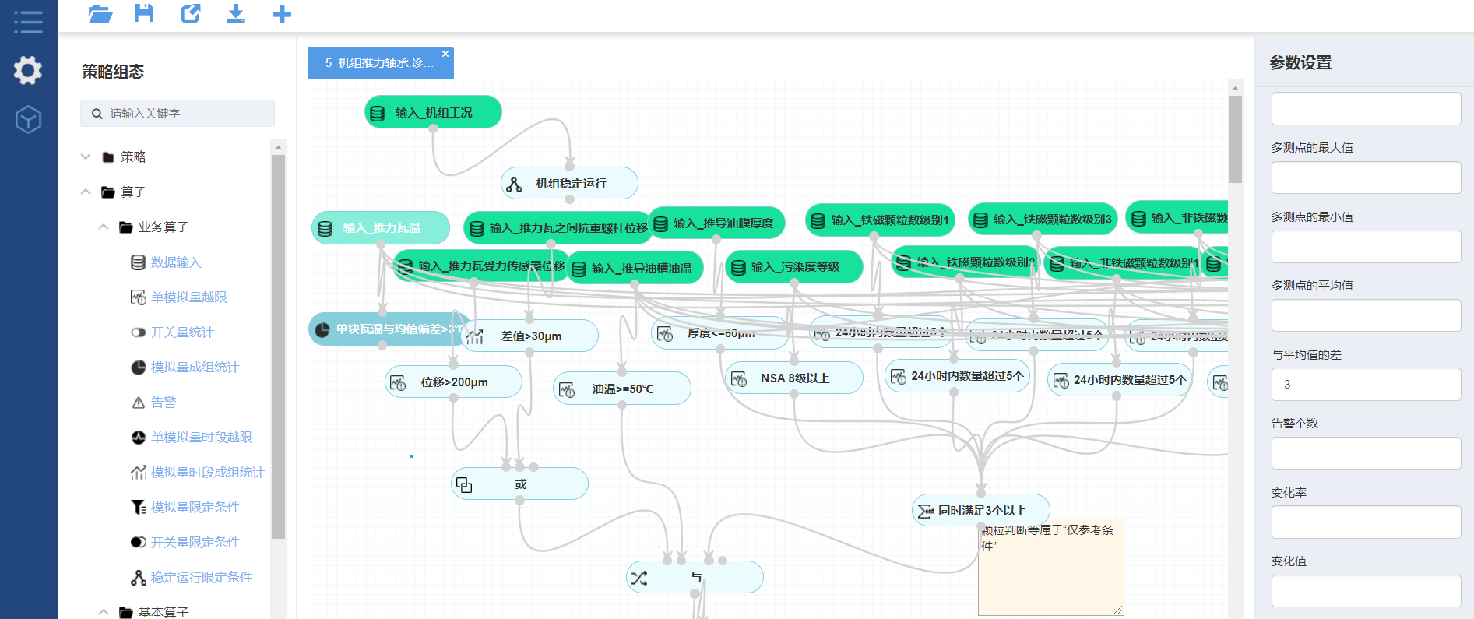
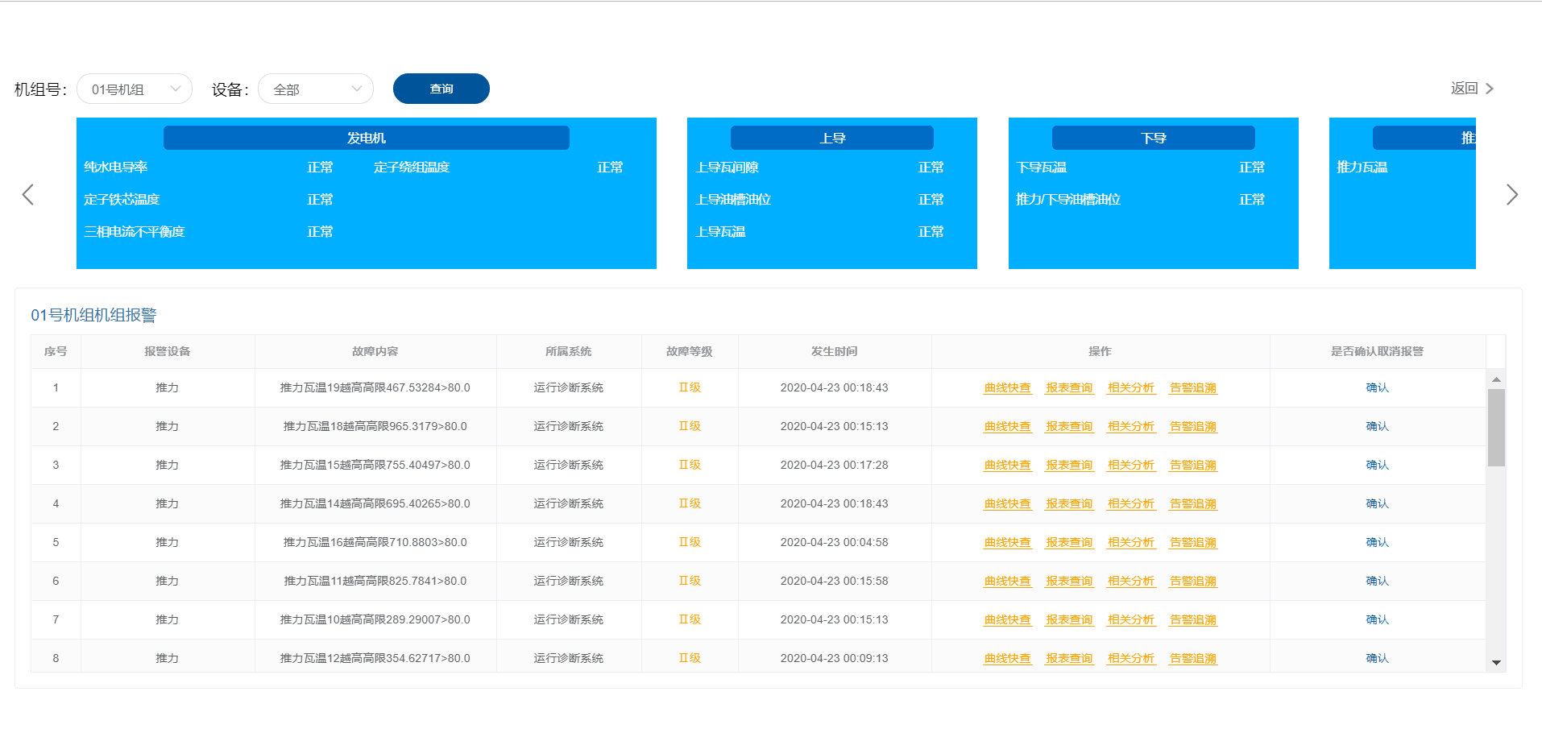
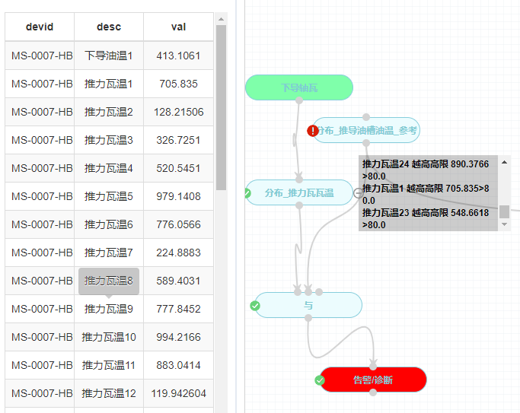
Establish a fault diagnosis reasoning model for hydropower units to carry out online fault diagnosis of the units and their auxiliary equipment.
Step2
Step1
The deployment creates a feedback loop: Alarm → Evaluate → Model Improvement, ensuring continuous system enhancement and operational reliability.
Step 3
Step 4
Trace

Slide 17
VALUE, RISKS, AND BUILT-IN CONTROLS
EMBEDDING SYSTMATIC CHECKS IN EVALUATION AND DEPLOYMENT PHASES MAKES QUALITY CONTINUOUS, NOT AN AFTERTHOUGHT.
Value: Fewer surprises, faster learning loops, repeatable outputs that simplify onboarding and audit.
Risks & Controls:
Bias/Fairness: evaluate by segments; run bias checks; document mitigations.
Privacy/Security: minimize PII; enforce role-based access; log data lineage.
Leakage/Overfitting: time-aware splits; feature lineage reviews; holdouts/back tests.

Slide 18
REUSABLE CHECKLIST
HOW TO USE CRISP-DM IN THIS COURSE
BU: one-page problem statement with KPIs, constraints, and success thresholds.
DU: a simple data inventory + a one-page quality/EDA summary.
Prep: a feature catalog (name, definition, lineage) and explicit split rules.
Model: an experiment log (ID, params, metrics, data version); keep the baseline.
Eval: a short go/no-go memo linking metrics to business KPIs and risks.
Deploy: a sketch of serving, monitoring metrics, alerting, and rollback criteria—even if hypothetical.

Slide 19
CONCLUSION：RECAP AND HAND-OFF TO THE DEEP-DIVE TEAMS
CRISP-DM provides a common roadmap and vocabulary. The six phases emphasize testable goals, early visibility into data realities, engineered reliability in preparation and modeling, decision-ready evaluation, and safe, observable deployment. Iteration is intentional and supported by small, standard deliverables. With this foundation, the next teams will deep-dive each phase.
→
→
A Structured Path
Scalable & Universal
Iterative Success
Adopt the CRISP-DM cycle as the backbone of your data projects to ensure they are effective, repeatable, and aligned with business value.

Slide 20


Thank You!
Hope you got useful knowledge
from this presentation.

